Slide 1
Lecture 01 – Classifying images
SIN 393 – Introduction to Computer Vision (2023)
Prof. João Fernando Mari
joaofmari.github.io
joaof.mari@ufv.br

Slide 2
Agenda
Digital images
A classification problem
Classification pipelines
Learning models
Cross-validation
Classification evaluation

Slide 3

Digital images
 | 0 |  |  |  |  |  |  |  |  |  |  |  |  |  | N-1 |  | y
0
M-1
x

Slide 4

Digital images
origin (0, 0)
column y
 | 0 |  |  |  |  |  |  |  |  |  |  |  |  |  | N-1 |  | y
0
M-1
x
row x
f(x, y) = I
M rows
N columns
M × N pixels
Intensity image

Slide 5
Digital images
origin (0, 0)
column y
 | 0 |  |  |  |  |  |  |  |  |  |  |  |  |  | N-1 |  | y
0
M-1
x
row x
f(x, y) = [R, G, B]
M rows
N columns
M × N pixels
Colored image (RGB)

Slide 6
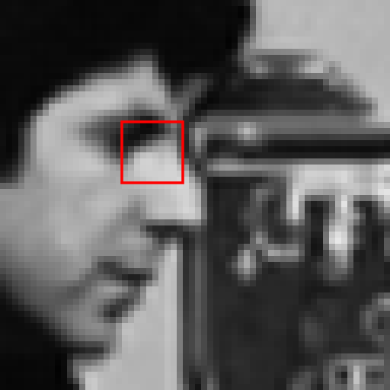
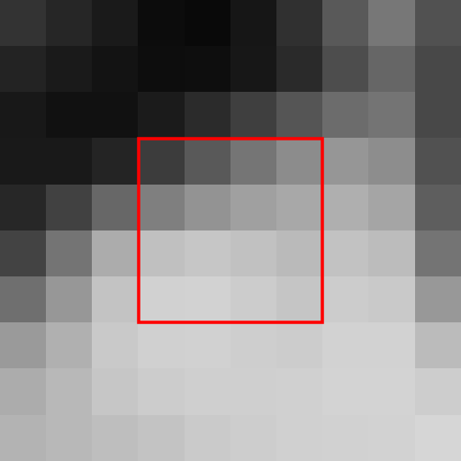

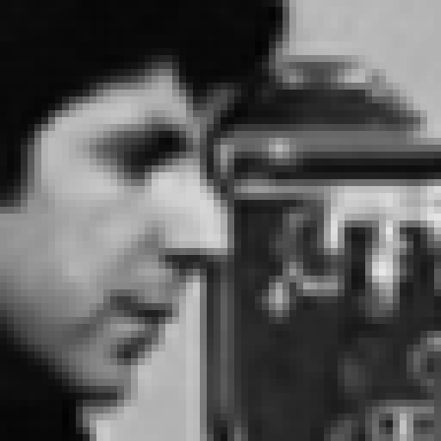


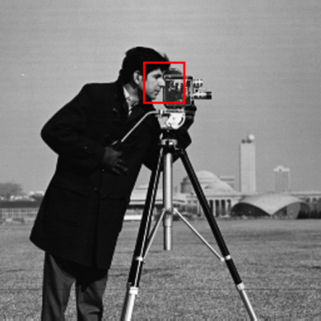
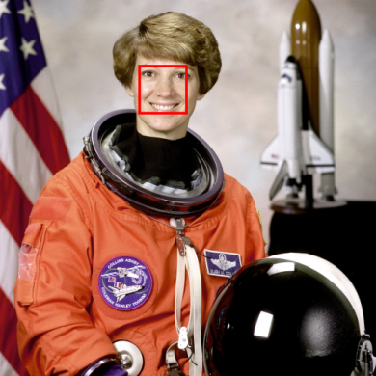
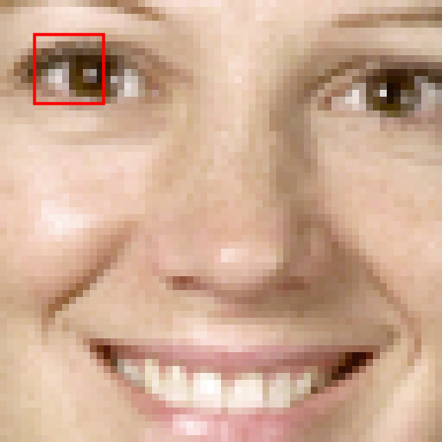
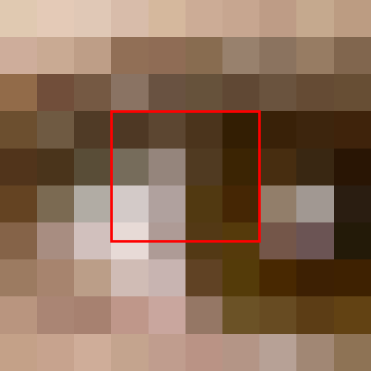

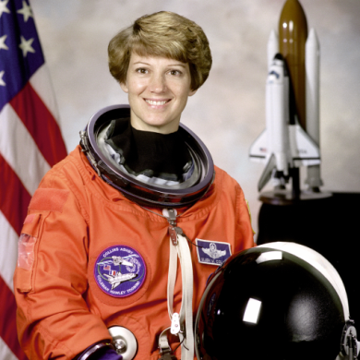


Digital images
Intensity image (gray levels):
Colored image (RGB):

Slide 7
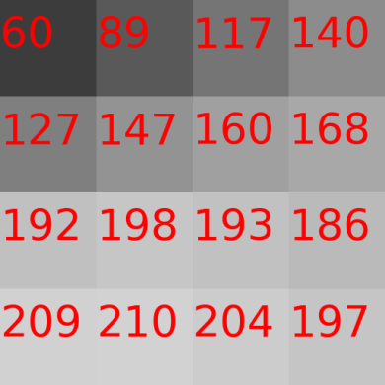
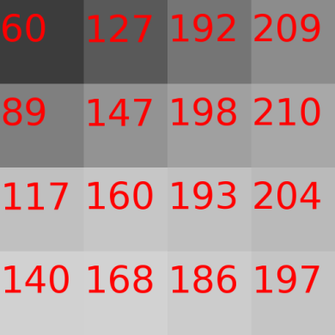
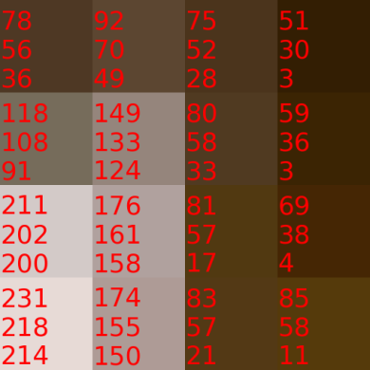
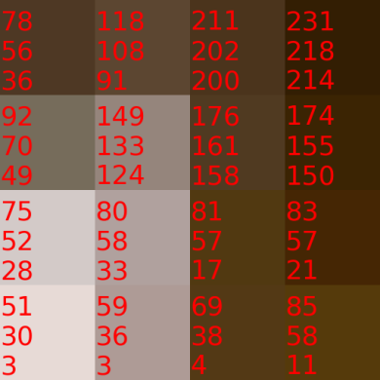
Digital images
Intensity image (gray levels):
Colored image (RGB):

Slide 8
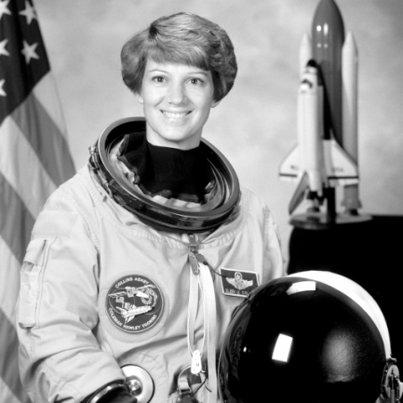
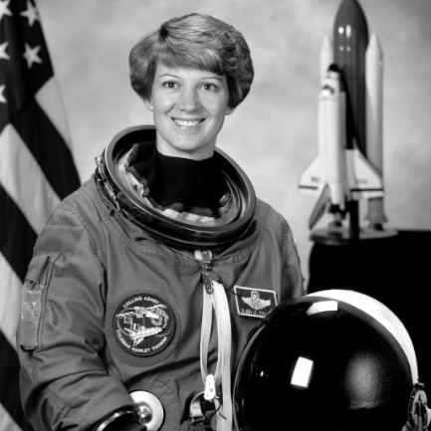
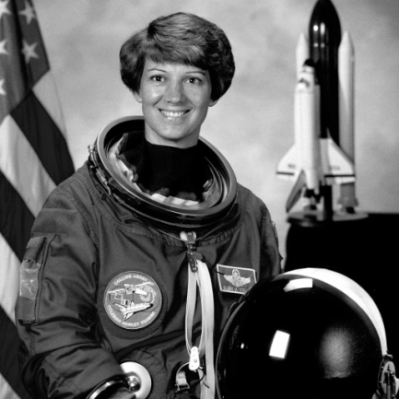
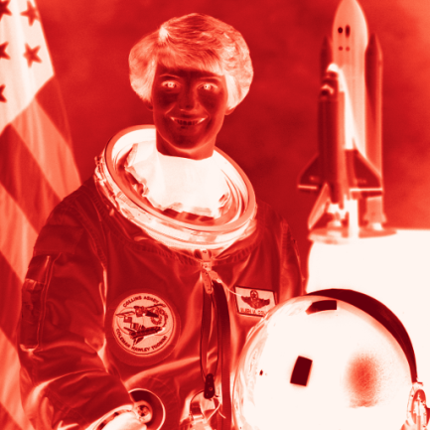
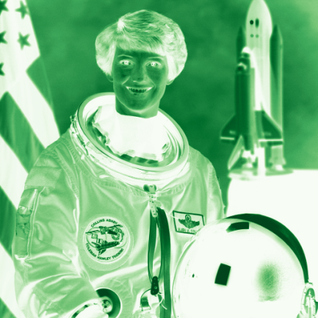
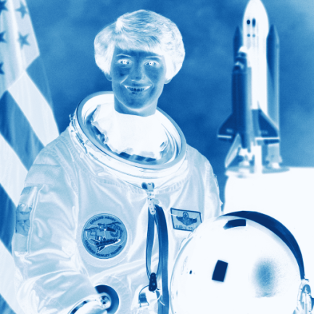
Colored images – RGB
vermelho – R (red)
verde – G (green)
azul – B (blue)

Slide 9



Colored images – RGB
red – R (red)
green – G (green)
blue – B (blue)

Slide 10
Colored images – RGB
B
Blue (0, 0, 255)
Cyan (0, 255, 255)
255
Magenta (255, 0, 255)
White (255, 255, 255)
Gray (127, 127, 127)
Green(0, 255, 0,)
0
Black (0, 0, 0)
255
G
255
R
Red (255, 0, 0)
Yellow (255, 255, 0)

Slide 11
A classification problem

Slide 12


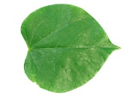


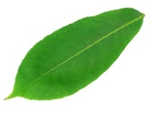
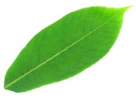

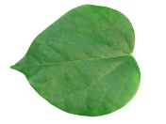
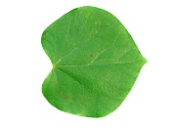



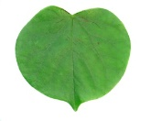
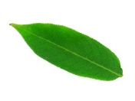

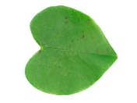

A classification problem
Learning to classify three types (classes) of leaves from images.
Flavia leaf dataset:
http://flavia.sourceforge.net/
1,907 images
33 classes
We selected 3 classes:
aesculus chinensis
acer palmatum
cercis chinensis

Slide 13
A classification problem
Learning to classify three types (classes) of leaves from images.
Feature extraction:
Select features from the images that can be used to distinguish between the classes.
Features can be:
Shapes
Colors
Textures
Histogram of gradients (HoG)
Bag of Visual Words
Fisher Vectors
...
aesculus chinensis
acer palmatum
cercis chinensis

Slide 14
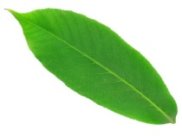
A classification problem
Some feature shapes:
Area:
aesculus chinensis
acer palmatum
cercis chinensis
Axis:
1,0
0,0
Roundness:
0,0
1,0
Excentricity:
Solidity:
÷
÷
https://scikit-image.org/docs/stable/api/skimage.measure.html#skimage.measure.regionprops

Slide 15
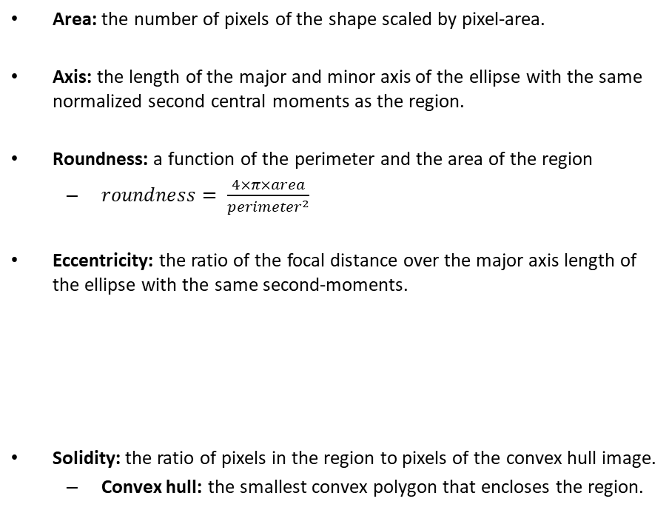
A classification problem
Some feature shapes:
Area: the number of pixels of the shape scaled by pixel-area.
Axis: the length of the major and minor axis of the ellipse with the same normalized second central moments as the region.
Roundness: a function of the perimeter and the area of the region
$roundness= \frac{4×π×area}{{perimeter}^{2}}$
Eccentricity: the ratio of the focal distance over the major axis length of the ellipse with the same second-moments.
Solidity: the ratio of pixels in the region to pixels of the convex hull image.
Convex hull: the smallest convex polygon that encloses the region.
aesculus chinensis
acer palmatum
cercis chinensis
0
0.3
0.7
https://scikit-image.org/docs/stable/api/skimage.measure.html#skimage.measure.regionprops

Slide 16
A classification problem
Learning to classify three types (classes) of leaves from images.
acer palmatum
aesculus chinensis
cercis chinensis
Major-axis
Area

Slide 17
A classification problem
Learning to classify three types (classes) of leaves from images.
acer palmatum
aesculus chinensis
cercis chinensis
Major-axis
Area

Slide 18
The nearest neighbor method
Learning to classify three types (classes) of leaves from images.
acer palmatum
aesculus chinensis
cercis chinensis
Major-axis
Area

Slide 19
K-nearest neighbors – K-NN
Learning to classify three types (classes) of leaves from images.
acer palmatum
aesculus chinensis
cercis chinensis
Major-axis
k = 1
Area

Slide 20
K-nearest neighbors – K-NN
Learning to classify three types (classes) of leaves from images.
acer palmatum
aesculus chinensis
cercis chinensis
Major-axis
k = 3
Area

Slide 21
K-nearest neighbors – K-NN
Learning to classify three types (classes) of leaves from images.
acer palmatum
aesculus chinensis
cercis chinensis
Major-axis
k = 3
Area

Slide 22
Linear functions (Perceptrons)
Learning to classify three types (classes) of leaves from images.
acer palmatum
aesculus chinensis
cercis chinensis
Major-axis
Area

Slide 23
Linear functions (Perceptrons)
Learning to classify three types (classes) of leaves from images.
acer palmatum
aesculus chinensis
cercis chinensis
Major-axis
Area

Slide 24
Linear functions (Perceptrons)
Learning to classify three types (classes) of leaves from images.
acer palmatum
aesculus chinensis
cercis chinensis
Major-axis
Area

Slide 25
Classification pipelines

Slide 26
Classification pipelines
The classic image classification pipeline
Image
Feature extraction
Classifier
MANUAL
TRAINABLE
Deep Learning
Image
Feature extraction
(low-level)
Feature extraction
(mid-nível)
Feature extraction
(high-level)
Classifier
TRAINABLE
TRAINABLE
TRAINABLE
TRAINABLE
Yann LeCun’s Deep Learning Course at CDS - SPRING 2021

Slide 27
Learning models

Slide 28
Learning models
Supervised learning
Unsupervized learning
Reinforcement learning
Semi-supervised learning
Self-supervised learning

Slide 29
Supervised learning
MODEL
Input
Label

Slide 30
Supervised learning
MODEL
Input
Output
Label

Slide 31
Supervised learning
MODEL
Input
Output
Error
Label

Slide 32
Supervised learning
MODEL
Input
Output
Error
Label

Slide 33











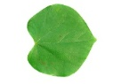






Example: Supervised learning
0
1
0
2
0
1
0
1
1
2
2
2
0
2
1
MODEL
Input
Output
Error
Label
0: acer palmatum
1: aesculus chinensis
2: cercis chinensis

Slide 34
Example: Supervised learning
1
0
2
0
1
0
1
1
2
2
2
0
2
1
MODEL
Input
Output
Error
Label
0
0: acer palmatum
1: aesculus chinensis
2: cercis chinensis

Slide 35
Example: Supervised learning
1
0
2
0
1
0
1
1
2
2
2
0
2
1
MODEL
Input
Output
1
Error
Label
0
0: acer palmatum
1: aesculus chinensis
2: cercis chinensis

Slide 36
Example: Supervised learning
1
0
2
0
1
0
1
1
2
2
2
0
2
1
MODEL
Input
Output
1
Error
> 0,0
Label
0
0: acer palmatum
1: aesculus chinensis
2: cercis chinensis

Slide 37
Example: Supervised learning
1
0
2
0
1
0
1
1
2
2
2
0
2
1
MODEL
Input
Output
1
Error > 0,0:
Adjust the model
Error
> 0,0
Label
0
0: acer palmatum
1: aesculus chinensis
2: cercis chinensis

Slide 38
Example: Supervised learning
0
0
2
0
1
0
1
1
2
2
2
0
2
1
MODEL
Input
Output
Error
Label
1
0: acer palmatum
1: aesculus chinensis
2: cercis chinensis

Slide 39
Example: Supervised learning
0
0
2
0
1
0
1
1
2
2
2
0
2
1
MODEL
Input
Output
2
Error
Label
1
0: acer palmatum
1: aesculus chinensis
2: cercis chinensis

Slide 40
Example: Supervised learning
0
0
2
0
1
0
1
1
2
2
2
0
2
1
MODEL
Input
Output
2
Error
> 0,0
Label
1
0: acer palmatum
1: aesculus chinensis
2: cercis chinensis

Slide 41
Example: Supervised learning
0
0
2
0
1
0
1
1
2
2
2
0
2
1
MODEL
Input
Output
2
Error > 0,0:
Adjust the model
Error
> 0,0
Label
1
0: acer palmatum
1: aesculus chinensis
2: cercis chinensis

Slide 42
Example: Supervised learning
0
1
2
0
1
0
1
1
2
2
2
0
2
1
MODEL
Input
Output
Error
Label
0
0: acer palmatum
1: aesculus chinensis
2: cercis chinensis

Slide 43
Example: Supervised learning
0
1
2
0
1
0
1
1
2
2
2
0
2
1
MODEL
Input
Output
0
Error
Label
0
0: acer palmatum
1: aesculus chinensis
2: cercis chinensis

Slide 44
Example: Supervised learning
0
1
2
0
1
0
1
1
2
2
2
0
2
1
MODEL
Input
Output
0
Error
= 0,0
Label
0
0: acer palmatum
1: aesculus chinensis
2: cercis chinensis

Slide 45
Example: Supervised learning
0
1
2
0
1
0
1
1
2
2
2
0
2
1
MODEL
Input
Output
0
Error = 0,0:
Do not adjust the
model
Error
= 0,0
Label
0
0: acer palmatum
1: aesculus chinensis
2: cercis chinensis

Slide 46
Example: Supervised learning
0
1
0
2
0
1
0
1
1
2
2
2
0
2
1
Continue until the model converges...
MODEL
Input
Output
0
Error
= 0,0
Label
0
0: acer palmatum
1: aesculus chinensis
2: cercis chinensis

Slide 47
Unsupervized learning
Input
Output
MODEL

Slide 48
Unsupervized learning
Input
Output
MODEL

Slide 49
Unsupervized learning
Input
Output
MODEL

Slide 50
Cross-validation

Slide 51
Overfiting
No overfiting
Overfiting

Slide 52
Overfiting
No overfiting
Overfiting

Slide 53
Overfiting
No overfiting
Overfiting
?
?
?

Slide 54
Hold-out cross-validation
Dataset
shuffle
Train
Test
Model training
MODEL
Test the model

Slide 55
Hold-out cross-validation
Dataset
shuffle
Train
Validation
Test
Model training
Hyperparameter
adjustment
MODEL
Best model
Test the model

Slide 56
Hold-out cross-validation
Train
Dataset
Shuffled dataset
Image | excentricidade | área | classe
13 | 0,5 | 300 | 0
11 | 0,8 | 700 | 1
8 | 0,4 | 400 | 0
9 | 0,8 | 150 | 2
2 | 0,3 | 350 | 0
15 | 0,7 | 250 | 2
4 | 0.5 | 800 | 1
7 | 0,7 | 750 | 1
10 | 0,9 | 300 | 2
12 | 0,4 | 150 | 0
3 | 0,6 | 550 | 1
6 | 0,6 | 200 | 2
Image | excentricidade | área | classe
0 | 0,1 | 250 | 0
1 | 0,6 | 450 | 2
2 | 0,3 | 350 | 0
3 | 0,2 | 550 | 1
4 | 0,5 | 800 | 1
5 | 0,2 | 100 | 0
6 | 0,7 | 200 | 2
7 | 0,7 | 750 | 1
8 | 0,4 | 400 | 0
9 | 0,8 | 150 | 2
10 | 0,9 | 300 | 2
11 | 0,8 | 700 | 1
12 | 0,4 | 150
13 | 0,4 | 300
14 | 0,2 | 200
15 | 0,7 | 250
Image | excentricidade | área | classe
13 | 0,5 | 300 | 0
11 | 0,8 | 700 | 1
8 | 0,4 | 400 | 0
9 | 0,8 | 150 | 2
2 | 0,3 | 350 | 0
15 | 0,7 | 250 | 2
4 | 0.5 | 800 | 1
7 | 0,7 | 750 | 1
10 | 0,9 | 300 | 2
12 | 0,4 | 150 | 0
3 | 0,6 | 550 | 1
6 | 0,6 | 200 | 2
0 | 0,4 | 700 | 1
1 | 0,8 | 400 | 2
5 | 0,3 | 100 | 0
14 | 0,2 | 200 | 0
shuffle
split
Test
Image | excentricidade | área | classe
0 | 0,4 | 700 | 1
1 | 0,8 | 400 | 2
5 | 0,3 | 100 | 0
14 | 0,2 | 200 | 0

Slide 57
K-fold cross-validation
Dataset
shuffle
Train
Test
Train
Validation
k = 0
Train
Validation
Train
k = 1
Train
Validation
Train
k = 2
Train
Validation
Train
k = 3
Validation
Train
k = 4

Slide 58
Normalization

Slide 59
Normalization
Normal Feature Transform (Standard Scaler)
Training (X_{train})
Normalized Training (X’_{train})
Test (X_{test})
Imagem | excentricidade | área
13 | 0,50 | 300
11 | 0,80 | 700
8 | 0,40 | 400
9 | 0,80 | 150
2 | 0,30 | 350
15 | 0,70 | 250
4 | 0.50 | 800
7 | 0,70 | 750
10 | 0,90 | 300
12 | 0,40 | 150
3 | 0,60 | 550
6 | 0,60 | 200
Mean: | 0.60 | 408.33
Std. Dev.: | 0.1859 | 234.35
Imagem | excentricidade | área
13
11
8
9
2
15
4
7
10
12
3
6
Mean:
Std. Dev.:
Imagem | excentricidade | área
0 | 0,4 | 700
1 | 0,8 | 400
5 | 0,3 | 100
14 | 0,2 | 200
Normalized test (X’_{test})
Imagem | excentricidade | área
0
1
5
14
Mean:
Std. Dev.:

Slide 60
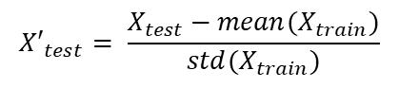
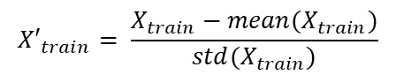
Normalization
Normal Feature Transform (Standard Scaler)
Training (X_{train})
Normalized Training (X’_{train})
Test (X_{test})
Imagem | excentricidade | área
13 | 0,50 | 300
11 | 0,80 | 700
8 | 0,40 | 400
9 | 0,80 | 150
2 | 0,30 | 350
15 | 0,70 | 250
4 | 0.50 | 800
7 | 0,70 | 750
10 | 0,90 | 300
12 | 0,40 | 150
3 | 0,60 | 550
6 | 0,60 | 200
Mean: | 0.60 | 408.33
Std. Dev.: | 0.1859 | 234.35
Imagem | excentricidade | área
13
11
8
9
2
15
4
7
10
12
3
6
Mean:
Std. Dev.:
Imagem | excentricidade | área
0 | 0,4 | 700
1 | 0,8 | 400
5 | 0,3 | 100
14 | 0,2 | 200
Normalized test (X’_{test})
Imagem | excentricidade | área
0
1
5
14
Mean:
Std. Dev.:
$${X′}_{train}= \frac{X_{train}−mean(X_{train})}{std(X_{train})}$$
$${X′}_{test}= \frac{X_{test}−mean(X_{train})}{std(X_{train})}$$

Slide 61
Normalization
Normal Feature Transform (Standard Scaler)
Training (X_{train})
Normalized Training (X’_{train})
Test (X_{test})
Imagem | excentricidade | área
13 | 0,50 | 300
11 | 0,80 | 700
8 | 0,40 | 400
9 | 0,80 | 150
2 | 0,30 | 350
15 | 0,70 | 250
4 | 0.50 | 800
7 | 0,70 | 750
10 | 0,90 | 300
12 | 0,40 | 150
3 | 0,60 | 550
6 | 0,60 | 200
Mean: | 0.60 | 408.33
Std. Dev.: | 0.1859 | 234.35
Imagem | excentricidade | área
13 | -0.5380 | -0.4622
11 | 1.0760 | 1.2445
8 | -1.0760 | -0.0355
9 | 1.0760 | -1.1022
2 | -1.6140 | -0.2489
15 | 0.5380 | -0.6756
4 | -0.5380 | 1.6712
7 | 0.5380 | 1.4578
10 | 1.6140 | -0.4622
12 | -1.0760 | -1.1022
3 | 0.0000 | 0.6044
6 | 0.0000 | -0.8889
Mean: | 0.00 | 1.00
Std. Dev.: | 0.00 | 1.00
Imagem | excentricidade | área
0 | 0,4 | 700
1 | 0,8 | 400
5 | 0,3 | 100
14 | 0,2 | 200
Normalized test (X’_{test})
Imagem | excentricidade | área
0 | -1.0760 | 1.244528
1 | 1.0760 | -0.035558
5 | -1.6140 | -1.315644
14 | -2.1521 | -0.888949
Mean: | -0.9415 | -0.2489
Std. Dev.: | 1.4150 | 1.1289
$${X′}_{train}= \frac{X_{train}−mean(X_{train})}{std(X_{train})}$$
$${X′}_{test}= \frac{X_{test}−mean(X_{train})}{std(X_{train})}$$

Slide 62
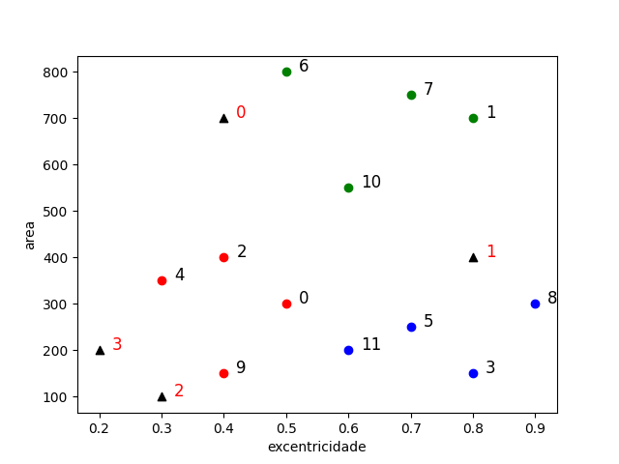
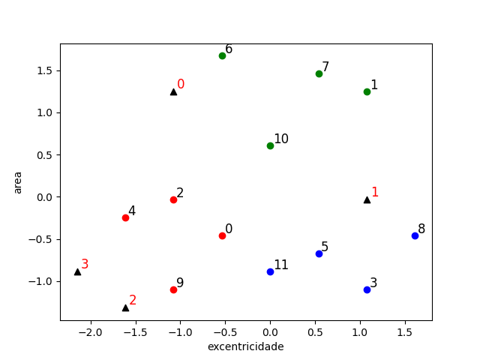
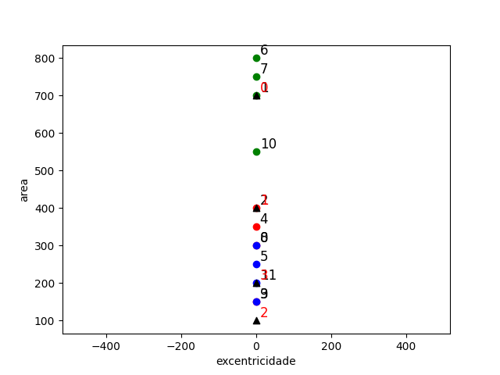
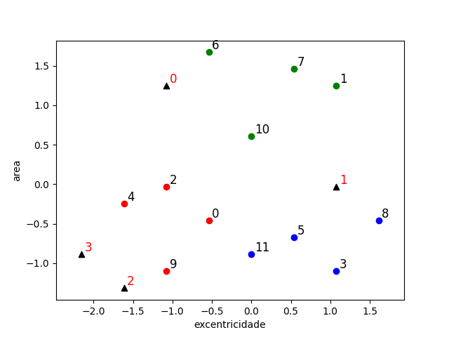
Normalization
Non-normalized dataset
Normalized dataset
Adjusted aspect ratio
Real aspect ratio

Slide 63
Classification evaluation

Slide 64
Confusion matrix
True positive(TP):
Objects of class C1 classified as C1.
True negative (TN):
Objects of other classes (C2 and C3) classified as not being C1.
False positive (FP) (type I error):
Objects classified as C1 but belonging to other classes (C2 or C3).
False negative (FN) (type II error):
Objects of class C1 classified as other classes (C2 or C3).
 |  | Classification
 |  | Class C1 | Class C2 | Class C3 | Sum
Real class | Class C1 | 5 | 3 | 0 | 8
 | Class C2 | 2 | 3 | 1 | 6
 | Class C3 | 0 | 2 | 11 | 13
 | Soma | 7 | 8 | 12

Slide 65
Confusion matrix
True positive(TP):
Objects of class C1 classified as C1.
True negative (TN):
Objects of other classes (C2 and C3) classified as not being C1.
False positive (FP) (type I error):
Objects classified as C1 but belonging to other classes (C2 or C3).
False negative (FN) (type II error):
Objects of class C1 classified as other classes (C2 or C3).
Class C1 |  | Classification
 |  | Class C1 |  | Others
Real class | Class C1 | 5 | TP | 3 | FN
 | Others | 2 | FP | 17 | TN
 |  | Classification
 |  | Class C1 | Class C2 | Class C3 | Sum
Real class | Class C1 | 5 | 3 | 0 | 8
 | Class C2 | 2 | 3 | 1 | 6
 | Class C3 | 0 | 2 | 11 | 13
 | Soma | 7 | 8 | 12

Slide 66
Confusion matrix
True positive(TP):
Objects of class C1 classified as C1.
True negative (TN):
Objects of other classes (C2 and C3) classified as not being C1.
False positive (FP) (type I error):
Objects classified as C1 but belonging to other classes (C2 or C3).
False negative (FN) (type II error):
Objects of class C1 classified as other classes (C2 or C3).
Class C1 |  | Classification
 |  | Class C1 |  | Others
Real class | Class C1 | 5 | TP | 3 | FN
 | Others | 2 | FP | 17 | TN
 |  | Classification
 |  | Class C1 | Class C2 | Class C3 | Sum
Real class | Class C1 | 5 | 3 | 0 | 8
 | Class C2 | 2 | 3 | 1 | 6
 | Class C3 | 0 | 2 | 11 | 13
 | Soma | 7 | 8 | 12

Slide 67
Confusion matrix
True positive(TP):
Objects of class C1 classified as C1.
True negative (TN):
Objects of other classes (C2 and C3) classified as not being C1.
False positive (FP) (type I error):
Objects classified as C1 but belonging to other classes (C2 or C3).
False negative (FN) (type II error):
Objects of class C1 classified as other classes (C2 or C3).
Class C1 |  | Classification
 |  | Class C1 |  | Others
Real class | Class C1 | 5 | TP | 3 | FN
 | Others | 2 | FP | 17 | TN
Class C2 |  | Classification
 |  | Class C2 |  | Others
Real class | Class C2 | 3 | TP | 3 | FN
 | Others | 5 | FP | 16 | TN
 |  | Classification
 |  | Class C1 | Class C2 | Class C3 | Sum
Real class | Class C1 | 5 | 3 | 0 | 8
 | Class C2 | 2 | 3 | 1 | 6
 | Class C3 | 0 | 2 | 11 | 13
 | Soma | 7 | 8 | 12

Slide 68
Confusion matrix
True positive(TP):
Objects of class C1 classified as C1.
True negative (TN):
Objects of other classes (C2 and C3) classified as not being C1.
False positive (FP) (type I error):
Objects classified as C1 but belonging to other classes (C2 or C3).
False negative (FN) (type II error):
Objects of class C1 classified as other classes (C2 or C3).
Class C1 |  | Classification
 |  | Class C1 |  | Others
Real class | Class C1 | 5 | TP | 3 | FN
 | Others | 2 | FP | 17 | TN
Class C2 |  | Classification
 |  | Class C2 |  | Others
Real class | Class C2 | 3 | TP | 3 | FN
 | Others | 5 | FP | 16 | TN
 |  | Classification
 |  | Class C1 | Class C2 | Class C3 | Sum
Real class | Class C1 | 5 | 3 | 0 | 8
 | Class C2 | 2 | 3 | 1 | 6
 | Class C3 | 0 | 2 | 11 | 13
 | Soma | 7 | 8 | 12
Class C3 |  | Classification
 |  | Classe C3 |  | Others
Real class | Class C3 | 11 | TP | 2 | FN
 | Others | 1 | FP | 13 | TN

Slide 69
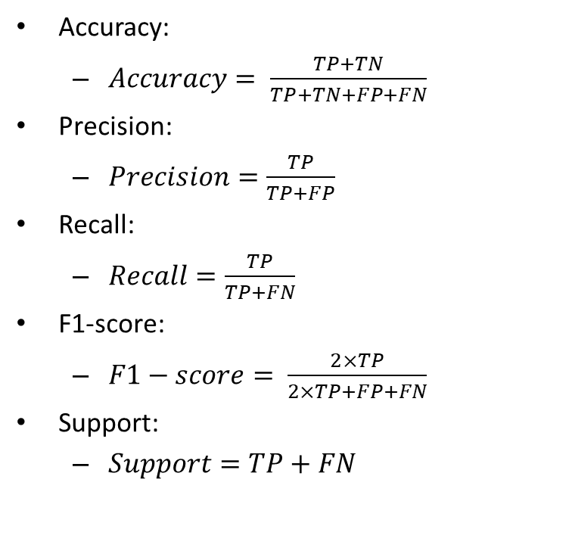
Accuracy, precision, recall, and F1-score
Accuracy:
$Accuracy= \frac{TP+TN}{TP+TN+FP+FN}$
Precision:
$Precision=\frac{TP}{TP+FP}$
Recall:
$Recall=\frac{TP}{TP+FN}$
F1-score:
$F1−score= \frac{2×TP}{2×TP+FP+FN}$
Support:
$Support=TP+FN$

Slide 70
Accuracy, precision, recall, and F1-score
Accuracy:
$Accuracy= \frac{TP+TN}{TP+TN+FP+FN}$
Precision:
$Precision=\frac{TP}{TP+FP}$
Recall:
$Recall=\frac{TP}{TP+FN}$
F1-score:
$F1−score= \frac{2×TP}{2×TP+FP+FN}$
Support:
$Support=TP+FN$
How close the classification is to the true value.
The ability of the classifier not to label a negative sample as positive.
The ability of the classifier to find all the positive samples.
The weighted harmonic mean of the precision and recall.
The number of occurrences of each real (true) class.
https://scikit-learn.org/stable/modules/generated/sklearn.metrics.precision_recall_fscore_support.html

Slide 71
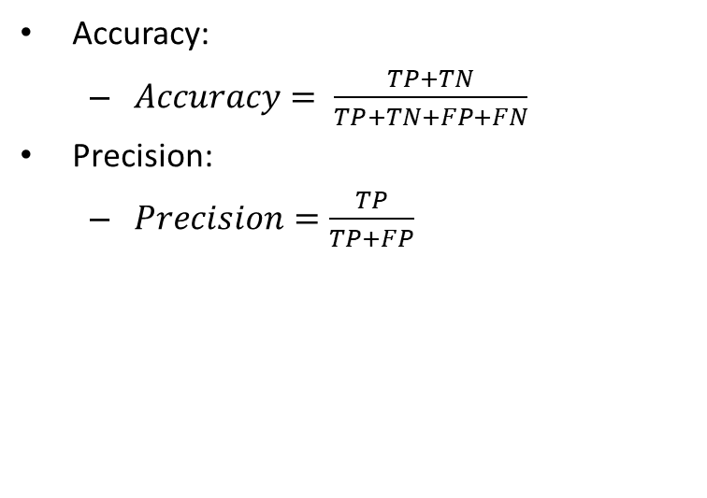
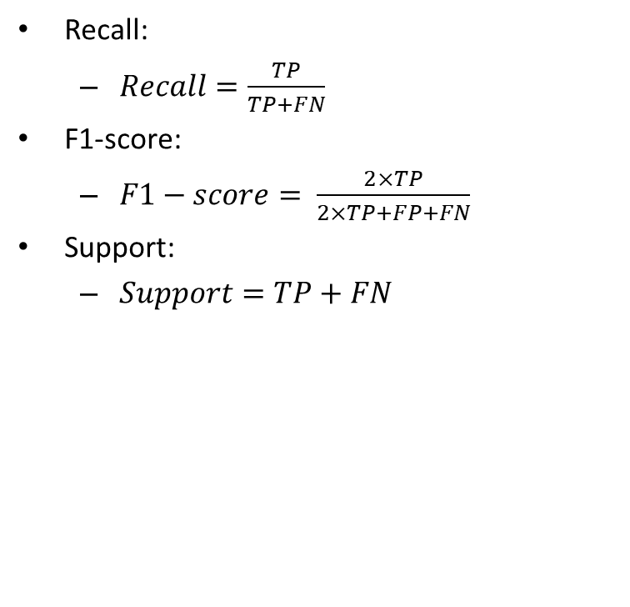
Accuracy, precision, recall, and F1-score
Accuracy:
$Accuracy= \frac{TP+TN}{TP+TN+FP+FN}$
Precision:
$Precision=\frac{TP}{TP+FP}$
Recall:
$Recall=\frac{TP}{TP+FN}$
F1-score:
$F1−score= \frac{2×TP}{2×TP+FP+FN}$
Support:
$Support=TP+FN$
Classes | TP | TN | FP | FN | Accuracy | Precision | Recall | F1-Score | Support
C1 | 5 | 17 | 2 | 3
C2 | 3 | 16 | 5 | 3
C3 | 11 | 13 | 1 | 2
MEAN
STD. DEV.

Slide 72
Accuracy, precision, recall, and F1-score
Accuracy:
$Accuracy= \frac{TP+TN}{TP+TN+FP+FN}$
Precision:
$Precision=\frac{TP}{TP+FP}$
Recall:
$Recall=\frac{TP}{TP+FN}$
F1-score:
$F1−score= \frac{2×TP}{2×TP+FP+FN}$
Support:
$Support=TP+FN$
Classes | TP | TN | FP | FN | Accuracy | Precision | Recall | F1-Score | Support
C1 | 5 | 17 | 2 | 3 | 0.8148 | 0.7143 | 0.6250 | 0.6667 | 8
C2 | 3 | 16 | 5 | 3 | 0.7037 | 0.3750 | 0.5000 | 0.4286 | 6
C3 | 11 | 13 | 1 | 2 | 0.8889 | 0.9167 | 0.8462 | 0.8800 | 13
MEAN
STD. DEV.

Slide 73
Accuracy, precision, recall, and F1-score
Accuracy:
$Accuracy= \frac{TP+TN}{TP+TN+FP+FN}$
Precision:
$Precision=\frac{TP}{TP+FP}$
Recall:
$Recall=\frac{TP}{TP+FN}$
F1-score:
$F1−score= \frac{2×TP}{2×TP+FP+FN}$
Support:
$Support=TP+FN$
Classes | TP | TN | FP | FN | Accuracy | Precision | Recall | F1-Score | Support
C1 | 5 | 17 | 2 | 3 | 0.8148 | 0.7143 | 0.6250 | 0.6667 | 8
C2 | 3 | 16 | 5 | 3 | 0.7037 | 0.3750 | 0.5000 | 0.4286 | 6
C3 | 11 | 13 | 1 | 2 | 0.8889 | 0.9167 | 0.8462 | 0.8800 | 13
MEAN |  |  |  |  | 0.8025 | 0.6687 | 0.6571 | 0.6584
STD. DEV. |  |  |  |  | 0.0761 | 0.2235 | 0.1431 | 0.1844

Slide 74
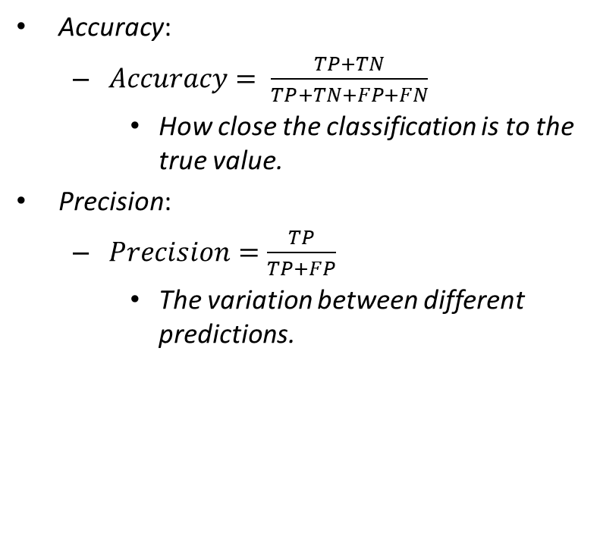
Accuracy Vs. Precision
Accuracy:
$Accuracy= \frac{TP+TN}{TP+TN+FP+FN}$
How close the classification is to the true value.
Precision:
$Precision=\frac{TP}{TP+FP}$
The variation between different predictions.
Precision
Accuracy

Slide 75
Bibliography
GONZALEZ, R.C.; WOODS, R.E.; Processamento Digital de Imagens. 3ª edição. Editora Pearson, 2009.
COSTA, L. DA F.; CESAR-JR., R. M. Shape analysis and classification: theory and practice. CRC Press, 2000. Chapter 8.
Yann LeCun’, Alfredo Canziani. Yann LeCun’s Deep Learning Course at CDS - SPRING 2021
https://cds.nyu.edu/deep-learning/
scikit-learn – User Guide.
https://scikit-learn.org/stable/user_guide.html

Slide 76
THE END

